Slide 1
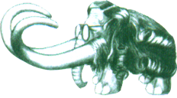
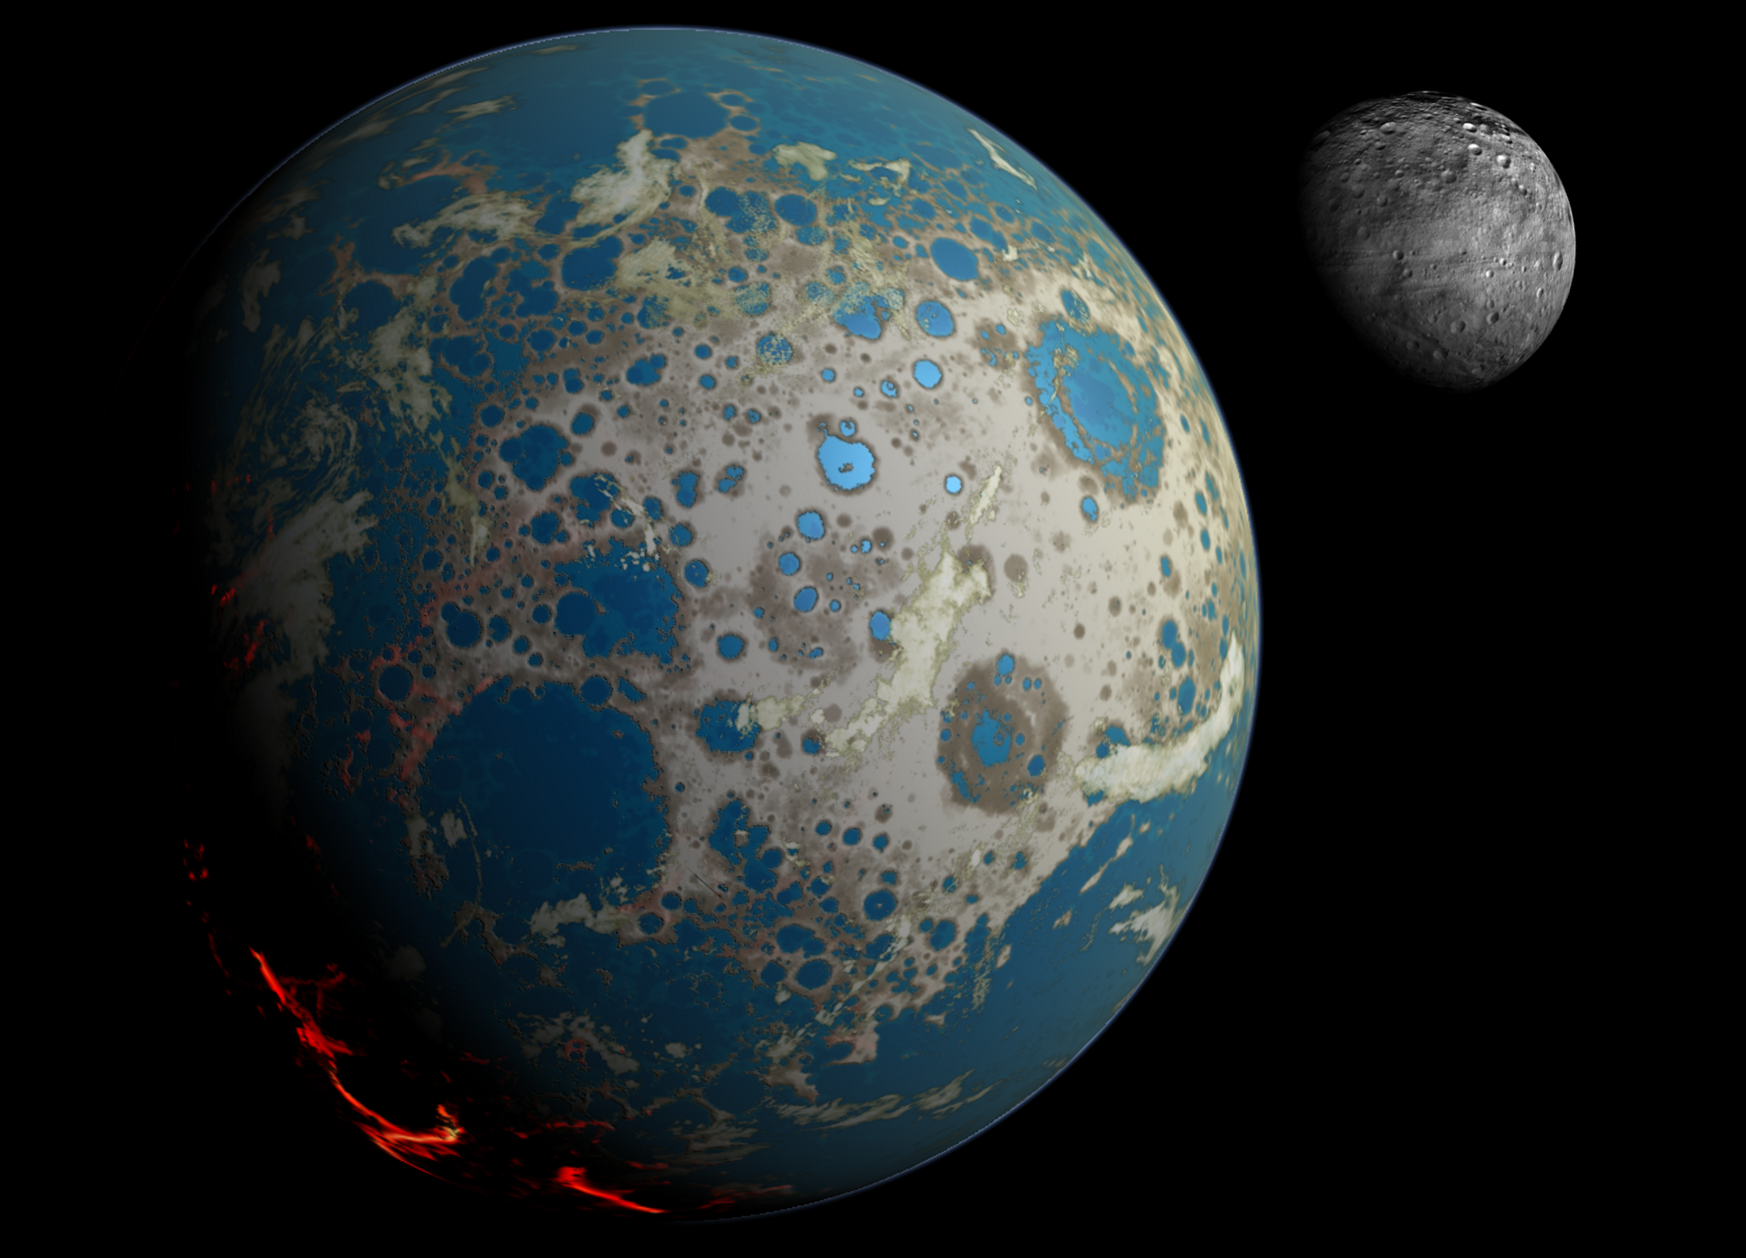

Dipartimento di Scienze della Terra, Università di Pisa
Corso di Geologia Planetaria
Corso di Dottorato Regionale di Scienze della Terra "Pegaso"
AVVISO DI SEMINARIO
Proto-Earth:
Widespread mixing and burial of Earth’s Hadean crust by asteroid impacts
dott. Simone Marchi
Solar System Exploration
Research Virtual Institute
Southwest Research Institute
Boulder, CO, USA
lunedi 13 giugno, 2016, ore 14:00, Aula C,
Dip. Scienze della Terra, Università di Pisa
info: luigi.folco@unipi.it
Notes:
Simone Marchi
Solar System Exploration Research Virtual Institute
Institute for the Science of Exploration Targets
Southwest Research Institute
Boulder, CO, USA
marchi@boulder.swri.edu
Abstract:
In this talk I will present a new bombardment model of the Hadean Earth, calibrated using existing lunar impact cratering data and highly siderophile elements concentrations on Earth. We show that the surface of the Hadean Earth was widely reprocessed by impacts through mixing and burial by impact-generated melt. This model may explain the absence of early terrestrial rocks.
Furthermore, I will discuss an intriguing correlation between the age distribution of Hadean zircons and the impact flux, suggesting that impacts played an important role in Hadean zircon formation.
In addition, by tracking the magnitude and timing of early collisions, we find that existing oceans would have repeatedly boiled away into steam atmospheres, as a result of large collisions as late as about 4 billion years ago.
Finally, I will discuss recent developments in understanding impact-induced effects on the tectonic evolution of the early Earth.

